Slide 1
History of algorithms and algorithmic thinking

Slide 2
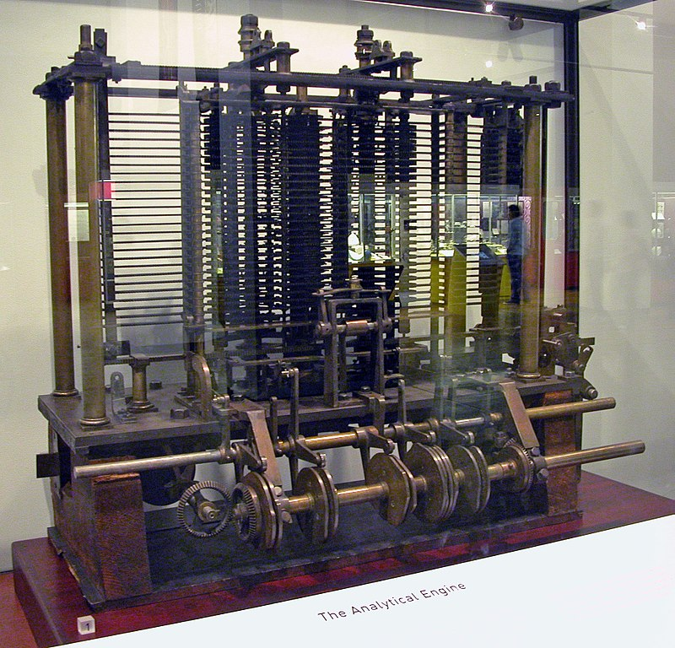
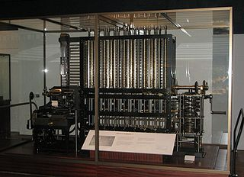
The first general-purpose computational machines
Differential Engine, Charles Babbage,
1822-1842
Analytical Engine,
Charles Babbage, 1837

Slide 3
The first general-purpose computational machines (cont.)
Were designed (not quite built) by british Charles Babbage in 1822-1842 and 1837
Were mechanical, general-purpose computers
Differential Engine would approximate functions like polynomial, logarithm, trigonometric
Analytical engine had also conditional statements, loops

Slide 4
Computer science
The term “computer science” first appeared in an article in Communications of the ACM (Association for Computing Machinery, www.acm.org) in 1959.
Computer science is a science that includes:
theoretical computer science : data structures and algorithms, computation theory, information and coding theory, programming languages
computer system: computer architecture and engineering, operating systems, computer networks, databases, concurrent and distributed systems, security
computer applications: artificial intelligence, graphics, audio-video proc. etc.
software engineering
Computer science is about “hardware” and “software”

Slide 5
History of computer science
The official science appeared in 1959
Hardware: computational machines like mechanical calculators appeared first in 1600, but they even existed in rudimentary forms (e.g. abacus) in ancient history, 2700 BC.
Software: the term “algorithm” was first invented by Muhammad ibn Musa al-Khwarizmi, the father of algebra, in a book written in 820 and translated into latin in the 12th century. Algorithm is derived from al-Khwarizmi’s name and refers to arithmetic techniques with hindu numerals

Slide 6
History of computer science (cont.)
Modern definition of algorithm: sequence of steps necessary in order to solve a specific problem (plus a set of data on which the operational steps operate)
Actually, this technique of solving a problem in steps (i.e. algorithmic thinking) can eventually be traced back to ancient history (Euclid’s algorithm – 300BC, Eratostene’s sieve – greeks) and even further back in time – as part of mathematics

Slide 7
The Babylonian
lived in Mesopotamia, a fertile plain between the Tigris and Euphrates rivers (present day Turkey and Syria); dates from around 2000-600BC; replaced the Sumerians and Akkadians
Famous for cuneiform writings (wedge-shaped symbols) – adopted from the Sumerians
Their texts remained on clay tablets
Advanced mathematics: extract square and cubic root, work with Pythagorean triples 1200 years before Pythagoras, had a knowledge of pi and possibly e (the exponential function), could solve some quadratics and even polynomials of degree 8, solved linear equations, deal with circular measurement

Slide 8
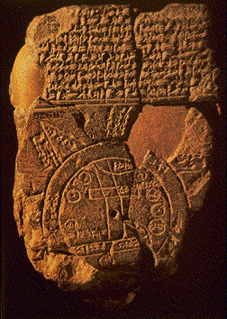
The Babylonian (2)
Babylonian Clay tablet

Slide 9
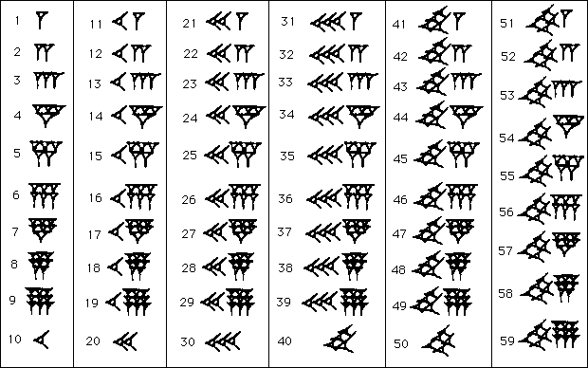
The Babylonian (3)
Sexagesimal (base 60) number system

Slide 10
The Babylonian math
Had tables for mathematical operations
Division algorithm: a/b = a x (1/b)
Reciprocal tables (1/a); 60 is a useful base here because many numbers have finite base 60 fractions, e.g. 1/2, 1/3, 1/4, 1/5, 1/6, 1/10, 1/12, 1/15 and 1/20; although some fractions were infinite (e.g. 1/7, 1/13)
Multiplication algorithms:
ab = [(a+b)² - a² - b²]/2 ab = [(a+b)² - (a-b)²]/4
Square and cube root approximations:
sqrt(a² + b) approx= a + b/2a

Slide 11
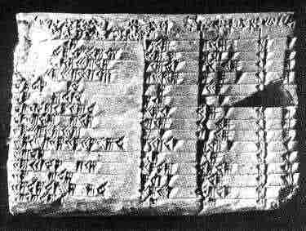
The Babylonian math (cont.)
Could solve quadratic equations like ax³ + bx² = c using tables
Had tables for powers of a number
Table with Pythagorean triplets:

Slide 12
The Egyptian
Had a decimal (base 10) number system; no zero
Very good in geometry, not so much in algebra, because they needed to measure areas (e.g. when the Nile would flood the land, they needed to measure it again); measure circles, ratios (pyramids)

Slide 13
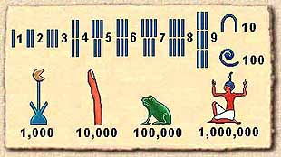
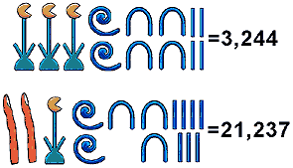
Egyptian number system

Slide 14
The Chinese
Math in China was for a long time hidden from other civilisations; a practical approach, not axiomatic
Gougu rule = chinese Pithagora theorem
Most famous book is Jiuzhang suanshu (Nine Chapters of the Mathematical Art) from around 100AD containing 246 practical problems:
Chapter 1: land surveying, area problems, additions/ substractions/ multiplications/ divisions of fractions, approx. PI
Chapter 2: exchange of goods, proportions
Chapter 3: proportions: direct, inverse, compound, arithmetic and geometric progressions
Chapter 4: areas, unit fractions
Chapter 5: problems on construction of canals, ditches, dykes; volumes
Chapter 6: ratio and proportions; fair distribution of goods
Chapter 7: linear equations solved by making two guesses at the solution, then computing the correct answer from the two errors
Chapter 8: solving systems of linear equations
Chapter 9: right angled triangles, Gougu rule, quadratic equations

Slide 15
The Maya

Slide 16
The Maya
Lived between 250 AD to 900 AD in Yucatan Peninsular (Mexico)
People lived in large cities (50.000 people in the city of Tikal)
Were conquered by spanish navigators in 1500 and their legacy largely destroyed
Had 2 calendars: a ritual calendar of 260 days and civil calendar of 365 days
Performed astronomical measurements
Did not use multiplications and divisions

Slide 17
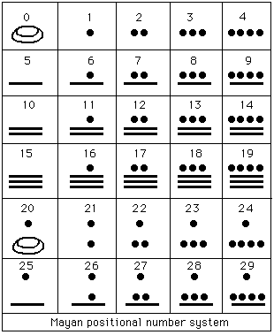
Maya number system
Had a base 20 number system

Slide 18
The Greeks
Thales of Milet
Pythagoras
Euclid
Archimedes
Eratosthenes
Heron of Alexandria
Klaudios Ptolemaeus
Diophantos of Alexandria
Hypatia

Slide 19
The Greeks
From 600BC to 500AD, the greeks made important contributions to mathematics and several other sciences
Algorithmic thinking was reflected in greek culture by Euclid’s algorithm for greatest common divisor and Eratostene’s sieve algorithm for finding prime numbers

Slide 20
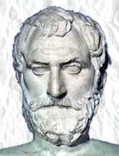
Thales of Milet (634-546 BC)

Slide 21
Thales of Milet (cont.)
Predicted the solar eclipse from May 28, 585 BC
Stated Thales’ theorem
Stated that the base angles of an isosceles triangle are equal
Believed the Earth was a flat disk floating on an infinite ocean

Slide 22
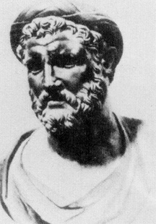
Pythagoras of Samos (560-480 BC)

Slide 23
Pythagoras (cont.)
Founded the mystic Pythagorean cult having the pentagram as symbol
Pythagoras was vegetarian but did not eat beans
Numbers were mystical for the cult and they believed numbers/proportions govern the matter
Developed the theory of Pythagorean numbers (a² = b²+c²)
Proved sqrt(2) is irrational number
Believed in reincarnation (even for animals)
Fundamental theory in music: dividing the length of a string into ratios of 1/2, 1/3, 1/4, and 1/5 creates the musical intervals of an octave, a perfect fifth, a second octave, and a major third respectively

Slide 24
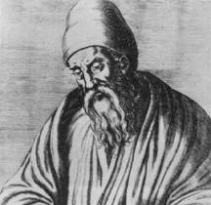
Euclid (ca. 325-ca. 270 BC)

Slide 25
Euclid (cont.)
Lived in Alexandria
Wrote the oldest book on rigorous mathematics: Elements
Elements began with postulates/axioms (common knowledge) and derived and proved all results from these postulates in a rigorous manner
Developed algorithm for finding the greatest common divisor

Slide 26
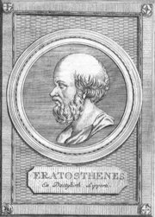
Eratosthenes (ca. 284-ca. 192 BC)

Slide 27
Eratosthenes
Measured the diameter of the Earth
Built a star map with 675 stars
Sieve of Eratosthenes algorithm for prime numbers

Slide 28
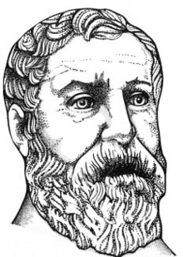
Heron of Alexandria (10 – 70 AD)
Built a steam engine
Developed an iterative algorithm/method for computing a square root of a number
Developed Heron’s formula for the area of a triangle

Slide 29
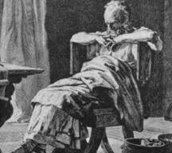
Archimedes of Syracuse (ca. 287-ca. 212 BC)

Slide 30
Archimedes (cont.)
Famous for physics law of Archimedes
Contributions in mathematics and physics
Various legends about his life:
Shouting “Eureka!”, running naked on the streets of Syracuse after discovering law of Archimedes
Setting roman ships on fire using large mirrors
Killed by a roman soldier

Slide 31
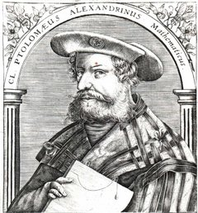
Klaudios Ptolemaios (85 – 165 AD)
Lived in Alexandria
Approximate PI
Formulated the geocentric model of the solar system (which lasted until it was negated by Copernicus in 1543 AD).

Slide 32
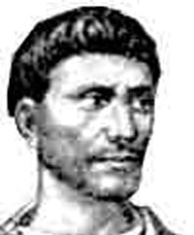
Diophantos of Alexandria (ca. 201/215 AD– ca. 285/299 AD)
Also known as the “father of algebra”
Wrote a collection of 13 books called “Arithmetica” (Pierre de Fermat wrote his last theorem on a side of Diophantus’ Arithmetica)

Slide 33
The Indian
Indian mathematics was influenced by the greeks, egyptians and babylonians, knowledge brought to India by Alexander the Great when he conquered India
Around 5 century AD indians moved from a greek number system to a babylonian-like one but in base 10.
They invented number zero
Because they decoupled numbers from their geometric significance, they also used negative numbers

Slide 34
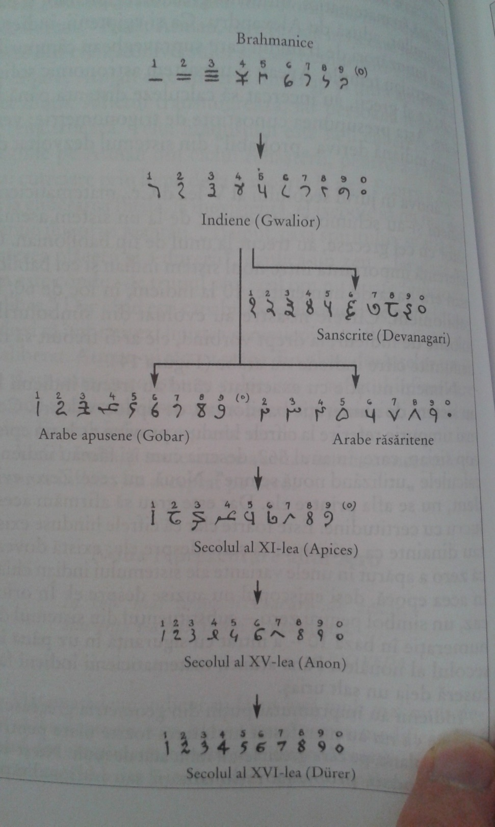
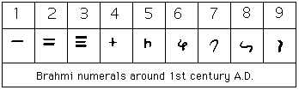
Indian numbers

Slide 35
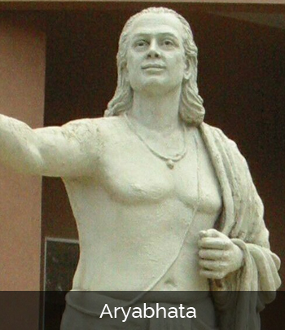
Aryabhata (476–550 AD)
Approximated PI
Approximated Earth and lunar rotations
Affirmed the theory of heliocentrism

Slide 36
Brahmagupa (598-668 AD)
Solved 1st degree, 2nd degree and some quadratic degree equations
Wrote the first book to treat zero as a number
Tried to define division by zero (0/0=0)
Stated arithmetic rules for positive and negative numbers and zero

Slide 37
The Arabic
The Islam rised by the year 700, occupying Egipt, Syria, Mesopotamia, Persia.
Islam advanced on the west until Spain and France and conquered China and India on the east
They would absorb the wisdom of the conquered people
They took the hindu base 10 numerals from indians and brought it back in Europe.

Slide 38
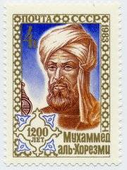
Abu Abdullah Muhammad bin Musa al-Khwarizmi (780-840 AD)

Slide 39
Abu Abdullah Muhammad bin Musa al-Khwarizmi (cont.)
Is considered the “father of algebra” because he wrote a book “Al-jabr w'al-muqabala”; “al-jabr” becomes “algebra” and it means “to complete a task”.
He wrote another book about hindu numbers that was translated in the 12 century to latin “Algoritmi de numero Indorum”; his name was translated into latin by “Algoritmi”; an “algorithm” would be a trick for working with hindu numbers.

